Slide 1



AWS STUDENT BUILDER GROUP
EGERTON UNIVERSITY
PRESENTS
CLOUD SCALING
AWS ELB
week
5
CLOUD
FORGE
Ephy Kimotho
9th July 2026
#AwsStudentbuilders

Slide 2







intro
Table of contents
INTRODUCTION TO LOAD BALANCING
Amazon EC2 Auto scaling
Types of Load Balancers
Scaling Policies
Target groups & Health checks
Listeners and Rules
#AwsStudentbuilders

Slide 3
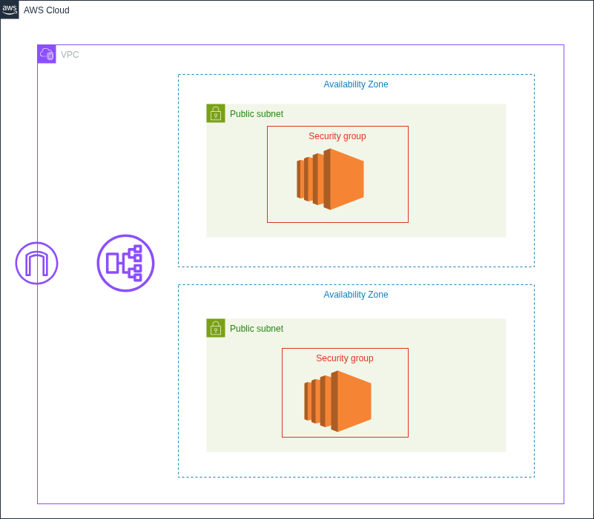
DEMO ARCHITECTURE DIAGRAM
#AwsStudentbuilders

Slide 4

WHAT IS LOAD BALANCING ?
When you design and build production grade solutions, you should avoid single point of failure (SPF). For example having one database instance or one application instance. In the event that either fails or is unavailable then your application will fail. It’s always good to have a backup plan in case such a scenario occurs.
One way to mitigate this is to design you architecture to be highly available. That is a system that can withstand some measure of degradation while still remaining available. Minimize Downtime as much as possible and with minimal human intervention.
Amazon Elastic Load Balancing (ELB) is a service that solves the SPF issue for AWS services. A Load balancer automatically distributes incoming traffic across multiple targets within a target group in one or more AZs.
A load balancer can be external/internet facing or internal facing. External facing load balancers distributes inbound public traffic while internal load ballancers distribute private traffic.
ELB monitors the health of it’s targets and send traffic to healthy instances only.
#AwsStudentbuilders

Slide 5
TYPES OF LOAD BALANCERS
We have 3 types of load balancers but in this demo we will only look the 2 most common ones.
Application Load Balancer - functions at the application layer (7) of the OSI MODEL and it routes HTTP and HTTPS traffic to targets that can be (EC2, Lambda, Containers, IP address). ALB typically sits in a public subnet and receives incoming user traffic and sends it to either web servers or application servers.
Network Load Balancers - functions at the network layer (4) of the OSI model. It can handle millions of requests per second to EC2 , Containers, ALB, or IP address targets. It supports TCP, UDP and TLS protocols and performs with ultra low latencies. It’s optimized to handle spiky traffic or volatile/unpredictable traffic patterns.
#AwsStudentbuilders

Slide 6
TARGET GROUPS AND health checks
A Target Group in AWS is a logical grouping of back-end resources (such as EC2 instances, IP addresses, containers, or Lambda functions) that receive incoming traffic from a load ballancer.
Each target group routes requests to one or more registered targets by using the protocol and port number set when you are creating the group.
To discover the availability of your EC2 targets, the load ballancer will periodically send pings, attempt connections, or send requests to test the EC2 instance. These periodic checks are known as Health checks.
Each registered target must respond to the health check with an HTTP status code of 200 for it to be considered healthy by the load ballancer.
If an unhealthy instance is detected, traffic will not be sent to that instance.
#AwsStudentbuilders

Slide 7
LISTENERS AND RULES
A listener is a process checks for connection requests from clients by using a protocol and port that you configure. A rule will determine how the load balancer routes the request to the targets. when the conditions for a rule are met then the appropriate action is taken.
Some listeners such as HTTPS or TLS listeners require SSL/TLS certificates on your load balancer to ensure that traffic is protected in transit. HTTPS and TLS protocols use encryption to secure messages sent over shared networks. You can use AWS Certificate Manager ACM to aquire these certificates for use on AWS services.
#AwsStudentbuilders

Slide 8
what is SCALING ?
Scaling is the ability to increase or decrease the compute capacity of your appliaction. Auto scaling is a mechanisim to achieve scaling with no or little human intervention. We have 2 types of scaling
Vertical scaling - where you increase or decrease the specifications of your existing resource. For example adding more Memory (RAM) or compute (vCPU) to your instances. With vertical scaling Downtime is inevitable and you will eventually reach a limit beacuse it’s hardware bound.
Horizontal scaling - is where you add or remove resources available to the application. That is adding more servers serving your application. Adding more resources is called scale-out while removing resources is called scale-in.
#AwsStudentbuilders

Slide 9
Amazon EC2 AUTO SCALING
In the cloud, scaling can be done automiatically, Amazon EC2 Auto Scaling does this by grouping EC2 intances into a management group called and Auto-Scaling Group ASG. This group can span across multiple AZs
An amazon EC2 ASG can automatically add or remove EC2 instances according to user-defined polices , scheduled actions, or ELB health checks.
When a new instance is added to the group, the launch template that species the instance will be used. Amazon EC2 Auto scaling integrates with Amazon ELB to distribute application traffic. It automatically registers new instances to a load balancers target group, and once the health checks pass, the load balancer can begin to route traffic to the new instance.
#AwsStudentbuilders

Slide 10
TYPES OF SCALING POLICIES
A scaling policy defines when a scaling action needs to happen by using rules. Let’s look at the types of scaling policies.
Schedule Action policy - here a scaling action is performed as a function of date and time.This policy is used when you have predictable workloads and know when to scale your instances.
Target-tracking policy - this policy increases or decreases the current capacity of a target group based on
a target value for a specific metric.
Predicitive scaling policy- where your capacity scales based on predicted demand. it works by analyzing historical laod data to detect daily, and weekly patterns and uses this info to forecast future capacity needs so that Amazon EC2 Auto scaling can proactively increase the capacity of your ASG to match anticipated load.
#AwsStudentbuilders

Slide 11
Benefits of scaling
It improves your application’s availability and reliablity
Auto scaling redues manual/human intervention for scaling to occur
Better cost management as auto-scaling can add and remove instances as needed.
It makes you architecture fault-tolerant.
#AwsStudentbuilders

Slide 12
LIVE DEMO
DEMO
#AwsStudentbuilders

Slide 13
AWS STUDENT BUILDER GROUP
EGERTON UNIVERSITY
Any
questions??
week
5
CLOUD
FORGE
Ephy Kimotho
9th July 2026
#AwsStudentbuilders

